Slide 1


Towards Learned Switch Behavior Modeling
Daqian Ding, Ziqian Liu, Zhixiong Niu, Ziyu Mao, Jingyu Wang, Yongqiang Xiong, Yiming Qiu
Notes:
This is Daqian Ding from the University of Hong Kong. Today I'll present our first step toward automatically learning a behavior model for a network switch. This is joint work between HKU and Microsoft Research.
[Transition: Let me begin with the operational problem.]

Slide 2


Imagine you are working as a network engineer debugging a switch
What’s wrong with the switch?
Hardware&software Bugs
New-introduced feature
Hidden behavior
❓
❓
❓
❓
❓
Blackbox, fix-functioned switch
Behavior space
Switches’ behaviors matters to network operation
Notes:
Consider a network engineer investigating unexpected behavior in a production switch. The cause may be a hardware or software bugs, a recently introduced feature, or an interaction omitted from the manual. From the operator's perspective, a fixed-function switch is a black box. We can install control-plane rules, send an ingress packet, and observe the result, but the internal decision process remains hidden. The behavior space also grows rapidly with packets, rules, and feature interactions. A targeted experiment may explain one incident, but it does not provide a reusable account of how the device will behave after the configuration or firmware changes. This is the gap that motivates our work.
[Transition: We first consider what can be learned from vendor documentation.]

Slide 3

Solution 1: check the documentation provided by vendors
Switch’s behavior covered by documentations
Doc’s description may more than or within the behavior space
Out of date
Coarse description of the actions
Mismatch with the real-world implementation
Notes:
Vendor documentation is an important source of prior knowledge. It identifies supported features and often gives a coarse view of pipeline order. However, the yellow region illustrates a possible gap between the written description and actual device behavior. The documentation may be out of date or omit details that matter only when features interact, such as precedence, table misses, or header rewriting. It is also written in prose, so it cannot directly predict the output for a particular packet and rule set. We therefore use documentation to initialize the model, but not as executable ground truth.
[Transition: Ground-truth observations must come from the hardware.]

Slide 4

Solution 2: probe the hardware
✅
✅
Egress packets
✅
Switch’s behaviors detected by probing
Ingress packets
Switch’s behaviors detected by probing
Unscalable
Poor interpretable
Time&resource intensive
Notes:
To obtain those observations, we probe the switch directly. We install a rule, send a packet, and record whether the packet is forwarded or dropped, the selected port, and any header changes. Each probe gives a reliable observation of the current device. The limitation here is coverage. A query represents only one point in a combinatorial space, while raw input-output pairs do not reveal which stage caused the outcome. Large-scale probing also consumes hardware time. Hardware observations are essential for validation, but by themselves they remain isolated examples rather than an interpretable model.
[Transition: We therefore need an executable model that connects documentation with observed behavior.]

Slide 5
Bridge the semantic gap
Documentations
Probing
Inexecutable
Poor interpretable
Executable behavior specification
Support offline validation
  Configuration
  Devices&versions behavior drift
  failure diagnoses
We need a behavior model!
Notes:
We argue the missing object here is an executable behavior model that combines these sources. Documentation supplies an initial structure, and observations align that structure with the device. The model can be used before deployment to check a configuration, or after an incident to identify where packet behavior diverged. It also provides a common basis for comparing devices or firmware versions. In this work, we focus on functional packet processing: whether a single packet is forwarded or dropped, which egress is chosen, and how headers are rewritten. Queueing and throughput are outside the current scope. Our objective is a useful semantic model of forwarding behavior rather than a complete digital twin.
[Transition: Lumen is our approach to learning this model.]

Slide 6
Lumen: Learned switch modeling
Documentation
Incremental synthesis
Model-centric alignment
Semantic parsing
Global behavior hypothesis
Match action specification
Feature dependency
behavior-space learning problem with counterexample-guided alignment
Notes:
This slide summarizes the Lumen workflow. We begin with vendor documentation and the controller API. Semantic parsing converts them into a preliminary scaffold that includes candidate features and their dependencies. Lumen then grows an executable model one observable slice at a time. After adding a slice, it generates tests for newly reachable behavior and runs the same cases on the switch. Any disagreement is returned as a counterexample, and the slice is revised before synthesis continues. This loop avoids synthesizing the entire switch in one step. Once the broad model is available, operational traces can expose behavior missed by model-generated tests. Lumen uses those traces to localize the remaining discrepancy and apply a bounded repair. The result is a model shaped by documentation but repeatedly checked against hardware.
[Transition: I will now describe the stages in more detail, beginning with semantic parsing.]

Slide 7
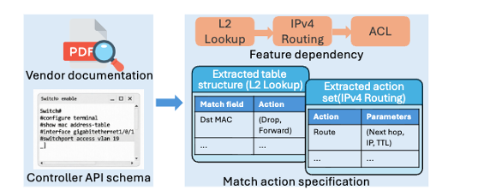
Stage1: Semantic parsing
Vendor documentation->macro level structure
Controller API schema->match action information
Notes:
[The first stage extracts a constrained synthesis problem from two complementary sources. Vendor documentation provides the approximate pipeline structure. In this example, it suggests that L2 lookup precedes IPv4 routing and the ACL. The controller API provides a more concrete description of available match fields, actions, and parameters. Lumen uses an LLM to interpret the prose, but treats the result as a candidate rather than a fact. It normalizes vendor-specific names and combines the extracted information with the API schema. The output is the match-action specification and dependency graph shown on the slide. These constraints substantially reduce the space that subsequent synthesis must explore.
[Transition: With this scaffold, Lumen can begin incremental synthesis.]

Slide 8
Stage2: incremental synthesis
L2 lookup
L3 forward
Recover the coarse
grained control flow
From execution traces
Increment the model following the decomposition
Network layering offer us natural boundaries inside the pipeline
Notes:
[The central design choice in incremental synthesis is the unit of growth. Adding a very small component, such as a parser rule, may not change any externally visible output, so the hardware cannot tell us whether it is correct. Lumen instead adds the smallest observable slice: enough parsing and match-action logic to create a new packet outcome. In this example, the model first captures coarse control flow, then adds L2 lookup, followed by L3 forwarding after its dependency is available. Each increment is immediately executable and can be tested on the switch. This keeps the synthesis problem manageable and, when a discrepancy appears, limits the likely cause to the newly added slice or its boundary with the existing model.
[Transition: Each slice is aligned with the device before the model grows further.]

Slide 9
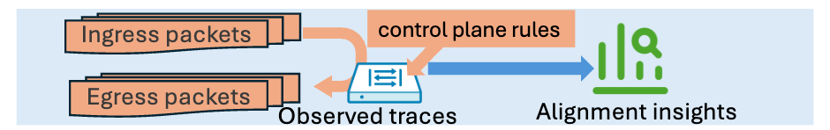
Stage2: Model-centric alignment
Model-centric alignment
Mismatch with hardware oracle
Notes:
After a slice is integrated, Lumen symbolically executes the updated model. An SMT solver generates packets and rule configurations that exercise the new paths, and the same cases are replayed on the hardware. If their outputs differ, the mismatch becomes a counterexample. Because the earlier model has already been checked, Lumen can localize the discrepancy to the new slice or its interaction with existing behavior, then refine it before continuing. We call this model-centric alignment because the current hypothesis determines which tests to run.

Slide 10
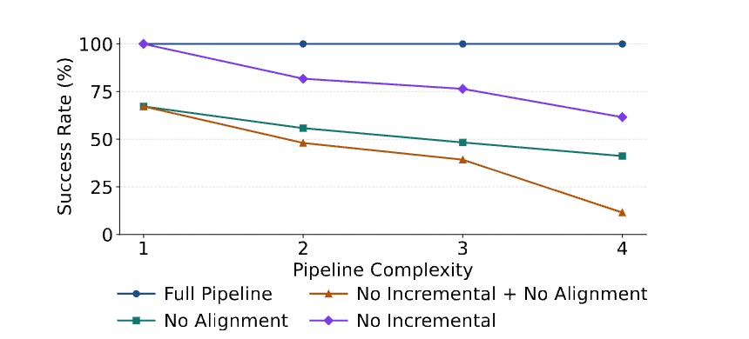
Preliminary Evaluation
Overall effectiveness
  Validate on tailored switch.p4
  Ablation study:
incremental synthesis and alignment are both required
Notes:
The preliminary evaluation use tailored switch.p4 which is a well used P4 software switch, while exposing only the black-box interface assumed by Lumen. Here we show an ablation study. As the modeled pipeline expands from L2 to include L3, ACL, and MPLS( which is pipeline complexity shown in the figure), the full system remains at 100 percent success in this experiment. Removing alignment and incremental reduces final success to about 40 to 60 percent. With both removed, success is around 10 percent. The result suggests that different mechanisms introduced in our work can be a promising solution for future synthesis task.

Slide 11
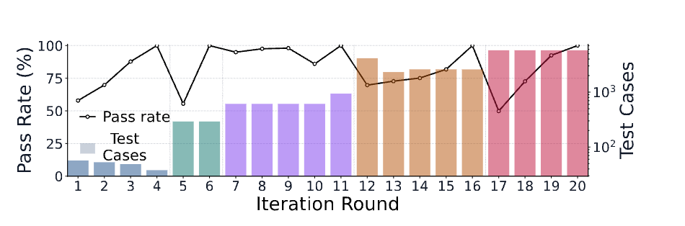
Preliminary solution
End-to-end workflow
overall workflow is viable
Notes:
This final plot follows one complete run. The bars report the number of test cases, and the black line shows the pass rate. During rounds ，Lumen adds features incrementally. We can see some short drops in pass rate are corrected near the point where each feature is introduced. These drop exposes a residual semantic gap in the model. After repair, the pass rate returns to nearly 100 percent. Our current prototype uses a lightweight repair heuristic: here we simply prompt coding agent to do the repair ; improving localization and constrained repair is an important next step. Overall, these results suggest that a fixed-function switch can be modeled by growing an executable hypothesis and repeatedly aligning it with observed hardware behavior.

Slide 12
Thanks!
Daqian Ding the University of Hong Kong daqian.ding0@gmail.com

